Slide 1
An Introduction to Deep learning and its applications

Slide 2
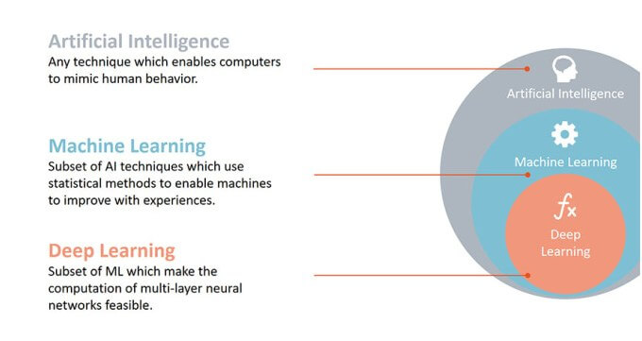
What is AI?

Slide 3
How Deep learning differs from Machine learning
Machine learning deals mostly with the structured data whereas Deep learning deals with unstructured data like images, video, etc.
We provide the features to the algorithms in Machine learning and the model performs depending on that.
Deep networks determines their own features and prioritises them accordingly.

Slide 4
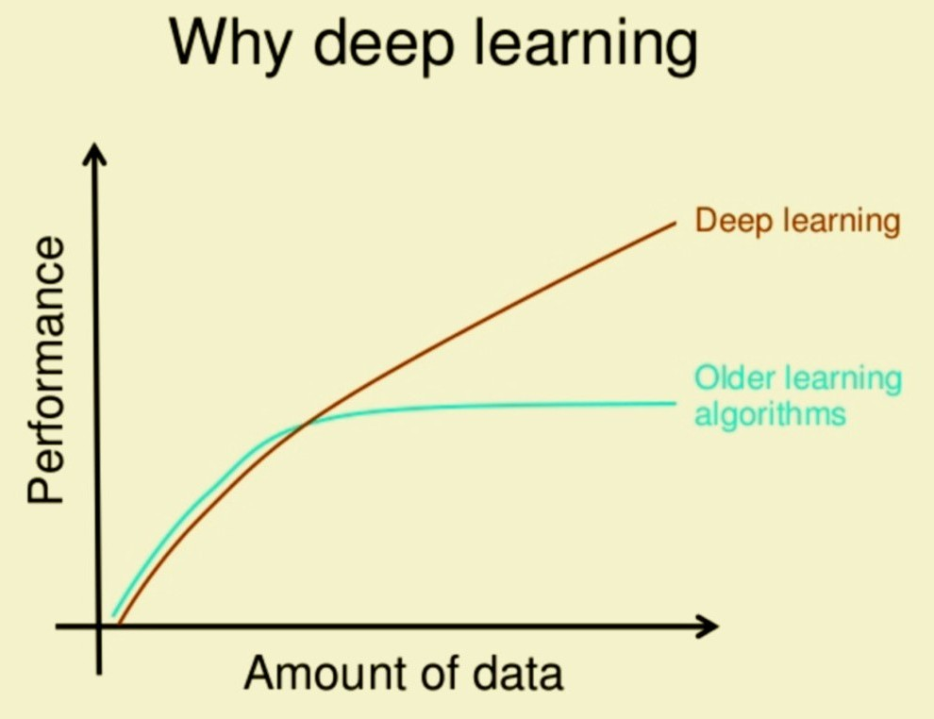

Slide 5
Three types of learning
Supervised learning - Data and also labels.
Unsupervised learning - Only data, no labels.
Reinforcement learning - We train agents in a specific environment by giving them rewards.

Slide 6
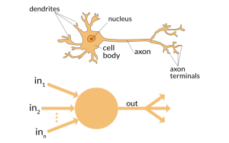
Neuron

Slide 7
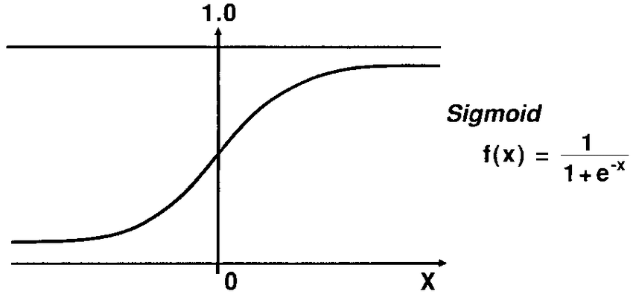
Logistic regression
Logistic regression is a classification algorithm where the predicted result is always between 0 and 1.
We have binary classification and also multi-class classification in this.
It is given by,
Z = W.T * X + b
Y = sigmoid(Z)

Slide 8
What exactly are features??
Features are any input variables that contribute in determining the output.
Example:
Titanic data - Age, Gender.
Computer vision applications - Each and every pixel of a image is considered as an essential feature.

Slide 9
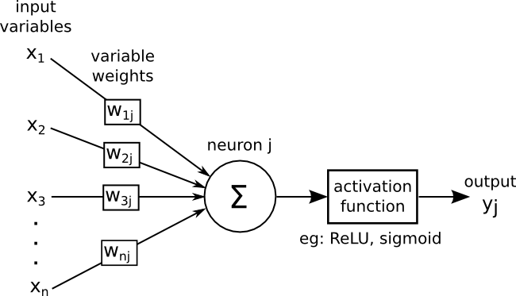
Logistic regression with Neural network

Slide 10
How do we train our network?
Let’s say we have 10000 images. Passing all these images through our model once is termed as “epoch”.
Different applications may need different number of epochs to train their model. For example, some applications may need 100 and some 1000 or more.
We measure the loss/accuracy of our model while it completes each epoch.

Slide 11
Neural network and architecture
The arrangement of these neurons in the form of a network is called a neural network.
Network architecture is just a specific way of arranging these neurons.
There are different architectures already built for computer vision applications. For example, VGG, ResNET, Inception etc.

Slide 12
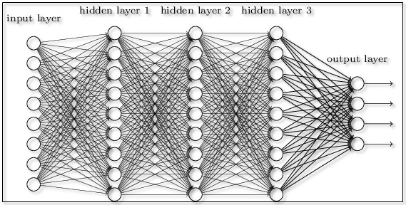
Neural network

Slide 13

The data used in the logistic regression model was very simple. It has only 28*28 features. The real world data looks very different from it.
It may have more number of input channels. It may have very high resolution. Both of which results in more and more number of input features.
RGB image with 3 channels.
Size let’s say 227*227 each.
Overall it is represented as, 227*227*3.

Slide 14
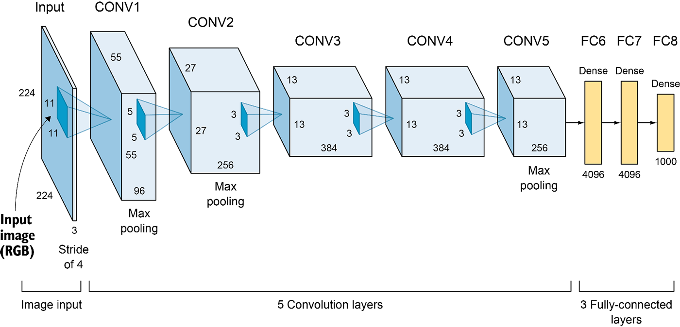
Alex Net

Slide 15
Let’s look at only the first layer of Alex-Net.
It accepts input images of size 227*227*3.
It applies 96 filters(Size 11*11) to these input images.
The output size will be: 55*55*96 (First layer)
The parameters that the network learns are weights and biases.
This is again given as input to the second layer where more number of filters are applied.

Slide 16
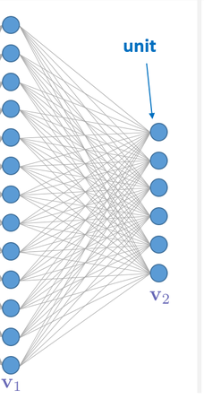
227*227*3
55*55*96

Slide 17
The total number of parameters is the total number of weights and biases.
Weights:
11*11 filers, 3 input channels and 96 such filters
Therefore, W = 11*11*3*96 = 34,848
Biases:
We have 96 output channels.
B = 96
Total parameters: W + B = 34,848 + 96 = 34,944
Similarly, we have 5 convolutional layers and three fully-connected layers.

Slide 18
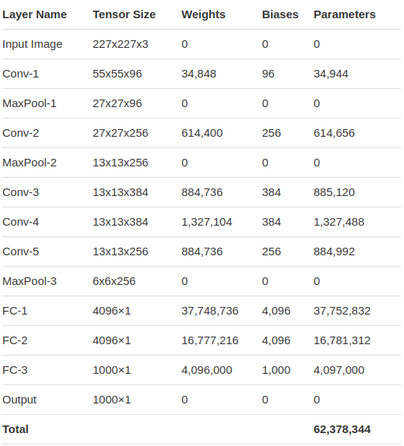

Slide 19
All these parameters are updated after each step in the learning process. In other words, they are updated after each iteration in the epoch. (We have more than one epochs)
The network what we saw is called Alex-Net and it is the first ever neural network.
There are more advanced network architectures that were introduced after, like GoogleNet, VGG, ResNet etc.
All these networks has more number of layers not just 8.

Slide 20
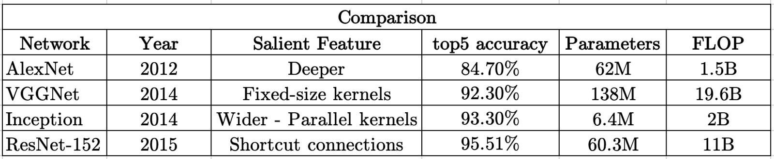
Network | # of layers
Alex-Net | 8
VGG | 16 & 19
GoogleNet | 22
ResNet | 18, 50, 101 and 152

Slide 21
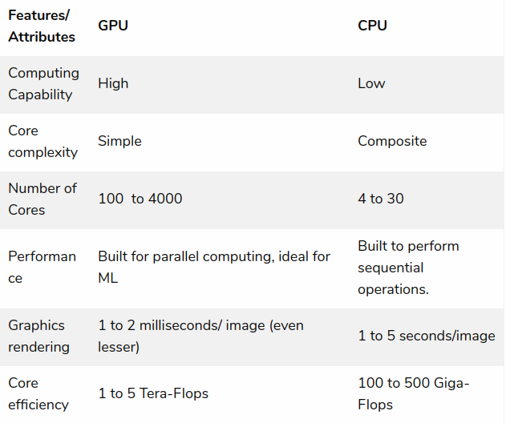

Slide 22
We have complex tasks like segmentation, image captioning, Face recognition and Self-driving cars.
Deeper networks with as many as thousand layers. Total number of parameters has gone up to 10 billion.
Some of these tasks require the model to do multiple tasks. Other tasks might require multiple models.
We can conclude that the more complex the task is the more complicated the network will become and we have more number of parameters.

Slide 23
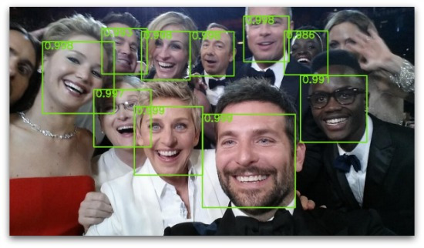
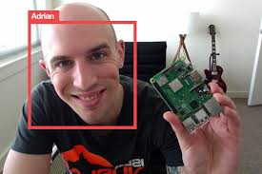
Face Recognition
Face recognition is actually a pipeline of two tasks: First we have to detect if a face is present in an image or not. Then, recognize the face if present.

Slide 24
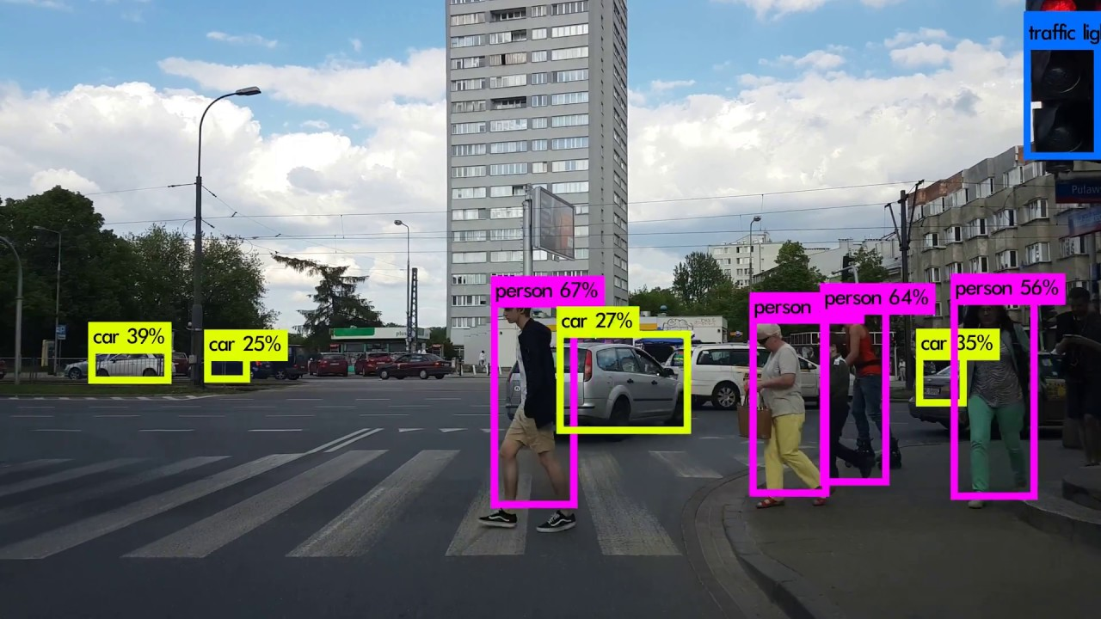
Self-driving cars

Slide 25


